Slide 1
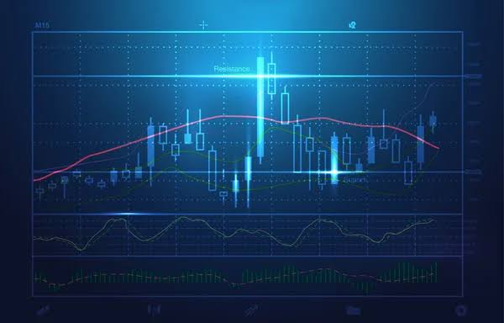
TRADING DATA ANALYSIS
REPRESENTED BY - BATCH-6

Slide 2

TEAM MEMBERS :-
DUVVA SURESH CSINP318 T L
RAMBA JAYA HARIKA CSINP327
KADIYAM UMAMAHESWARI CSINP339 (drop)
DOREDLA SARANYA CSINP342 (drop)
POLISETTY AMALA MARY CSINP346
PROMODH MADICHARLA CSINP353
SINDU CHINTA CSINP360

Slide 3

USING LIBRARIES TO IMPORT:-
NUMPY
PANDAS
MATPLOTLIB.PYPLOT
SEABORN
MATH

Slide 4

ATTRIBUTES :-
DATE
SCRIPT_ID
SECTOR
ExCHANGE
QUANTITY
TYPE
BROKER NAME
ORDERNO
TRADE_NAME
PAN_NO
UCC_NO
OPENPRICE
DAYHIGH
DAYLOW
BUYPRICE
SELL PRICE
GOVERNAMENT_SERVICE_TAX(GST)
SECURITIES_TRANSCATION_TAX(STT)
SECURITIES_AND_EXCHANGE_BOARD_OF_INDIA(SEBI) Fee
STAMPDUTY
BROKERAGE FEE
TOTAL_BUY_PRICE
TOTAL_SELL_PRICE
SUM_OF_TRANSATION_TAXES / QUANTITY
TOTAL_TRANSCATION_TAXES
NET

Slide 5

Steps followed in trading data analysis :-
Data collection.
Data pre-processing.
Data analysis.
Data visualization [output][graphs, heatmap, table].

Slide 6
DATA COLLECTION :-
In this step we either collect a dataset from the file and import to the notebook or we will be enterd data manually
Importing a data:
1.pd.read_excel(r’path’):reading a excel file
2.pd.read_json(r’path’):reading a json file

Slide 7
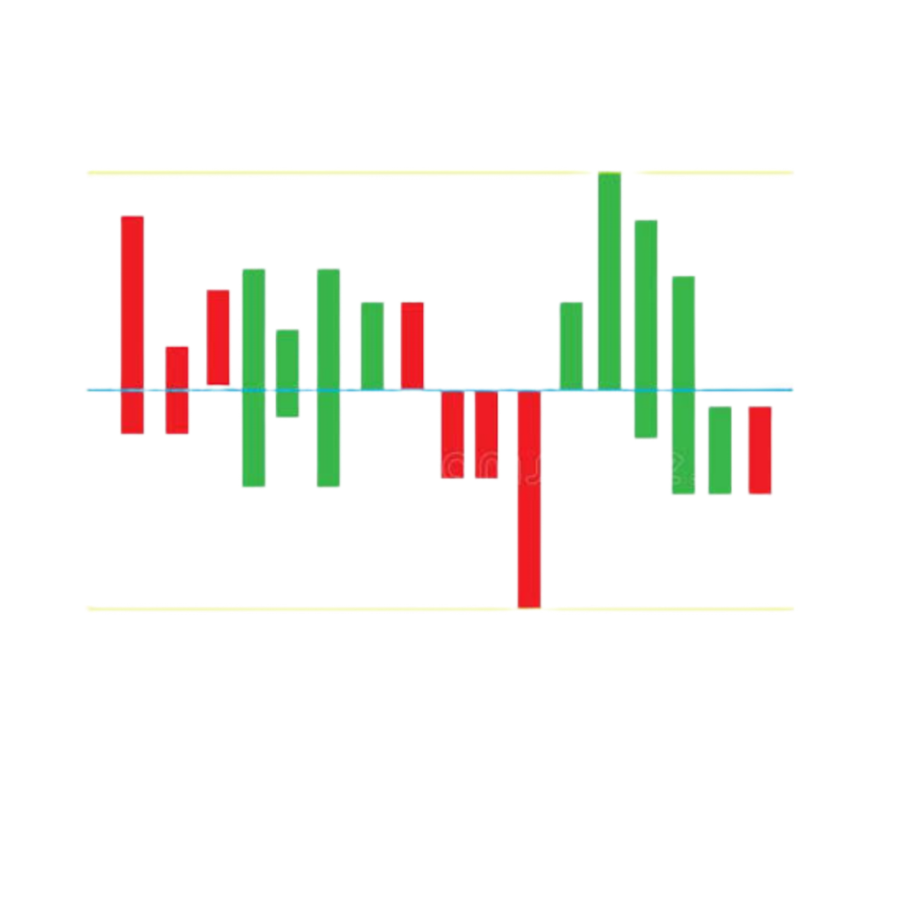
GENERATING DATA SET USING PANDAS
Generating a dataset:
We first create a dictonary with necessary attributes for the dataset and next we will be converting into the data Frame and save it as a excel in your directory
For converting a dictionary to a Data Frame we generally use a function called Data Frame(dictionary)
dataset=pd.DataFrame(data,columns=['DATE','SCRIPT_ID','SECTOR','EXCHANGE','QUANTITY','TYPE','BROKER_NAME','ORDERNO','TRADE_NAME','PERSON_NAME','PAN_NO','UCC_NO’])
dataset1=pd.DataFrame(Data,columns=['OPENPRICE','DAYHIGH','DAYLOW','BUYPRICE','SELLPRICE','GOVERNAMENT_SERVICE_TAX(GST)','SECURITIES_TRANSCATION_TAX(STT)','SECURITIES_AND_EXCHANGE_BOARD_OF_INDIA(SEBI)','STAMPDUTY','BROKERAGE_FEE','empty'])

Slide 8

DATA PRE-PROCESSING:
The goal is to improve the quantity of data and make it for suitable for specific mining task.
Steps in pre-processing:
1.Data Cleaning
2.Data Transformation
3.Data Reduction

Slide 9
DATA CLEANING :
Explore the data using head & tail functions
syntax :-
df.head() & df.tail()
To detect null values using isnull and notnull functions
syntax :-
df.isnull() & df.notnull()

Slide 10
DATA TRANSFORMATION:
It is converting the column data to right format, It includes normalization ,Standard Scaling , Label Encoding.
Filling of the missing data with proper data like filling with specific value or before values or after values.
Functions used:
df.fillna(mean(columnattribute)
example :
dataset['QUANTITY'].fillna(dataset['QUANTITY'].max(),inplace=True)

Slide 11
DATA REDUCTION:
In this step unwanted data is to be removed from the dataset.
We use the function:
Dropna()
Syntax:-
df=df.dropna(columnattribute,axis= none)
where axis = 0 then row wise removed
where axis = 1 then column wise removed

Slide 12
DATA ANALYSIS:
Here we use many techniques like
Data filtering
Data grouping
Computational Tools
Checking the statistics
Corelation and covariances (df.corr() & df.cov())
linear regression(regplot())

Slide 13
Data Filtering:
For required data :-
We can use the method filter to filter the data as you need or u can use the methods iloc(),filter(),loc() and indexing.
We can filter the data for Analysis based on
DATE , DAYHIGH , DAYLOW ,OPENPRICE
PERSON_NAME , TOTAL_BUY_PRICE , TOTAL_SELL_PRICE

Slide 14
Data Merging:
We need to merge the required cells into a table.
We can use the formula concat or filter the 2 or 3 columns from two tables and we need to concatenate them at end
df=pd.concat(data,axis= )
Either 0 for row
or 1 for column

Slide 15
DATA VISUALIZATION :
VISUALIZE THE DATA USING HEAT MAPS,BAR PLOT,LINE PLOT

Slide 16
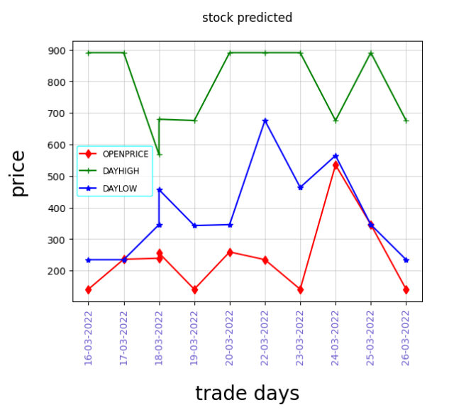
LINE PLOT FOR OPENPRICE,DAYHIGH,DAYLOW : -

Slide 17
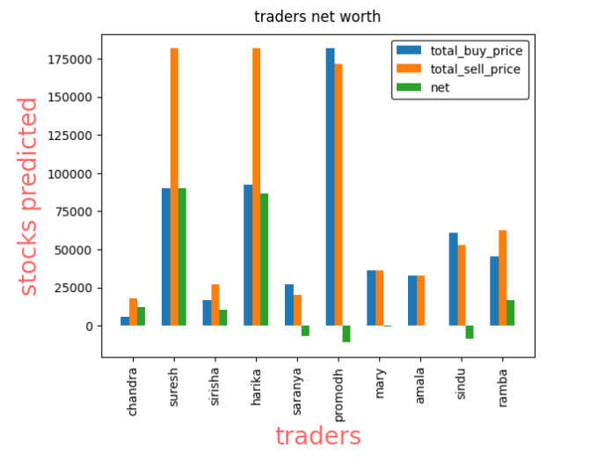
BAR PLOT FOR NET :-

Slide 18
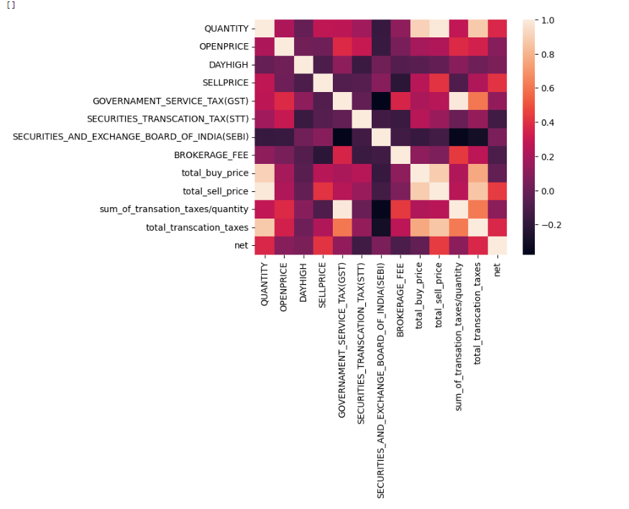
HEAT MAP :-

